Slide 1
Clustering Neighborhoods of London and Paris using Machine Learning

Slide 2
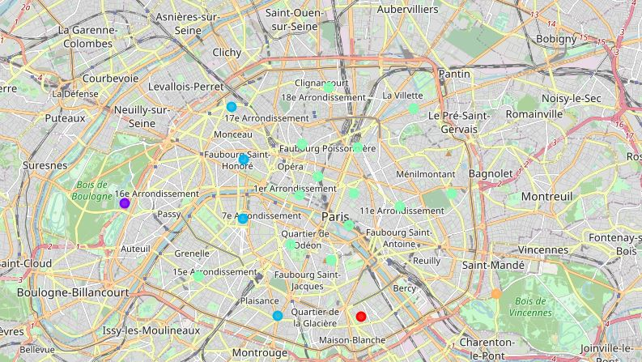
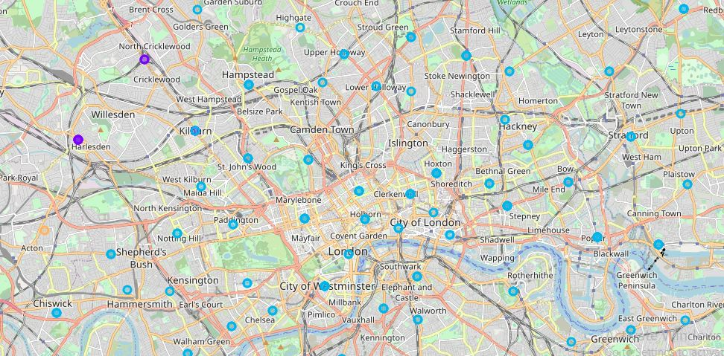
AIM
The aim is to help tourists choose their destinations depending on the experiences that the neighbourhoods have to offer and what they would want to have
This model also helps people make decisions if they are thinking about migrating to London or Paris
This model will help stakeholders make informed decisions and address any concerns they have.

Slide 3
Data Description
We require geographical location data for both London and Paris.
London
To derive our solution, We scrape our data from https://en.wikipedia.org/wiki/List_of_areas_of_London
Paris
To derive our solution, We leverage JSON data available at https://www.data.gouv.fr/fr/datasets/r/e88c6fda-1d09-42a0-a069-606d3259114e
ArcGIS API
ArcGIS Online enables you to connect people, locations, and data using interactive maps.
Foursquare API Data
Foursquare location platform will be used as the sole data source since all the stated required information can be obtained through the API.

Slide 4
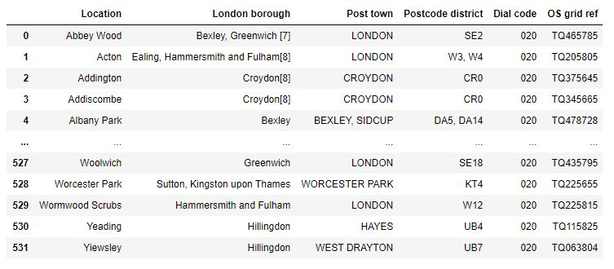
Data Collection - LONDON
url_london = "https://en.wikipedia.org/wiki/List_of_areas_of_London" wiki_london_url = requests.get(url_london) wiki_london_data = pd.read_html(wiki_london_url.text) wiki_london_data = wiki_london_data[1] wiki_london_data

Slide 5
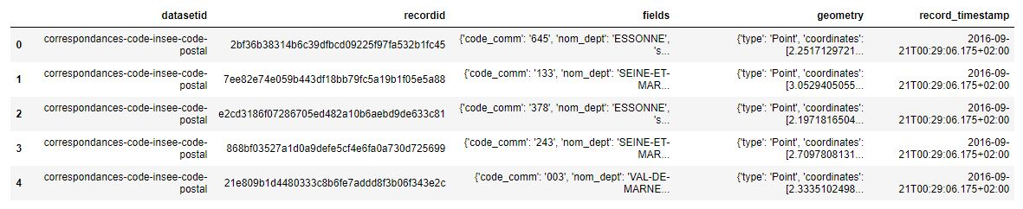
Data Collection - PARIS
!wget -q -O 'france-data.json' https://www.data.gouv.fr/fr/datasets/r/e88c6fda-1d09-42a0-a069-606d3259114e print("Data Downloaded!") paris_raw = pd.read_json('france-data.json') paris_raw.head()

Slide 6
Data Preprocessing
For London, We replace the spaces with underscores in the title. The borough column has numbers within square brackets
For Paris, we break down each of the nested fields and create the dataframe
wiki_london_data.rename(columns=lambda x: x.strip().replace(" ", "_"), inplace=True) wiki_london_data['borough'] = wiki_london_data['borough'].map(lambda x: x.rstrip(']').rstrip('0123456789').rstrip('['))
paris_field_data = pd.DataFrame() for f in paris_raw.fields: dict_new = f paris_field_data = paris_field_data.append(dict_new, ignore_index=True) paris_field_data.head()

Slide 7
Feature Selection & Engineering
For both of our datasets, we need only the borough, neighbourhood, postal codes and geolocations (latitude and longitude).
Both of our Datasets contain information related to all the cities in the country. We can narrow down and further process the data by selecting only the neighbourhoods of ‘London’ and ‘Paris’.
With the Help of ArcGIS API we can get the latitude and longitude of our London neighbourhood data.
from arcgis.geocoding import geocode from arcgis.gis import GIS gis = GIS()

Slide 8
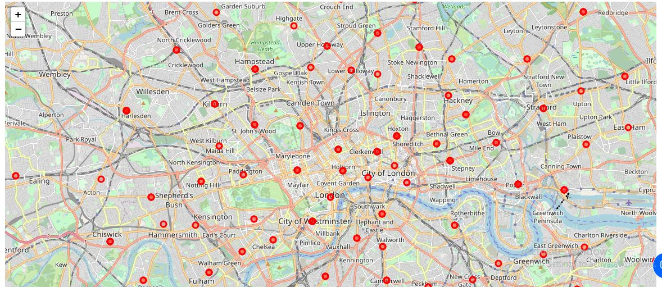
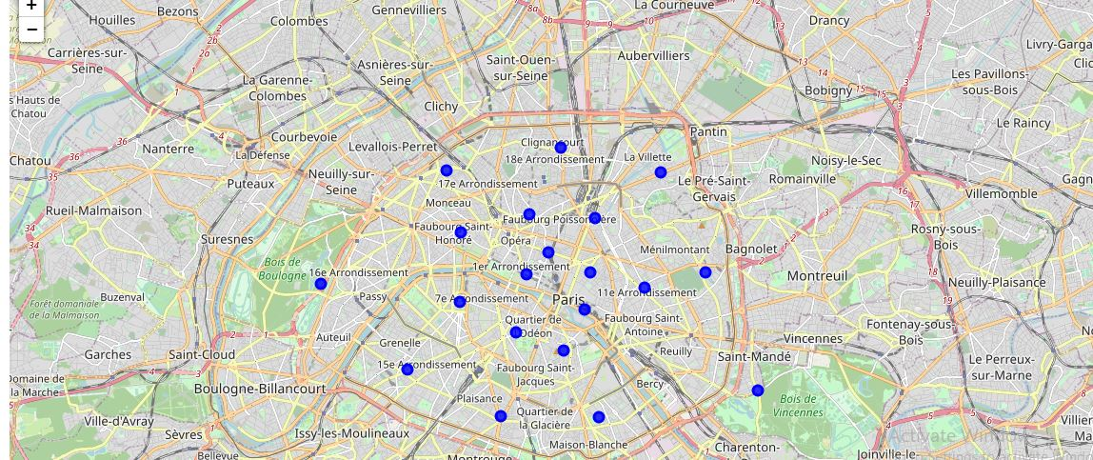
Visualizing the Neighborhoods of London and Paris
we have visualized the neighbourhoods, we need to find out what each neighbourhood is like and what are the common venue and venue categories within a 500 m radius.
This is where Foursquare comes into play. With the help of Foursquare we define a function which collects information pertaining to each neighbourhood including that of the name of the neighbourhood, Geo-coordinates, venue and venue categories.

Slide 9
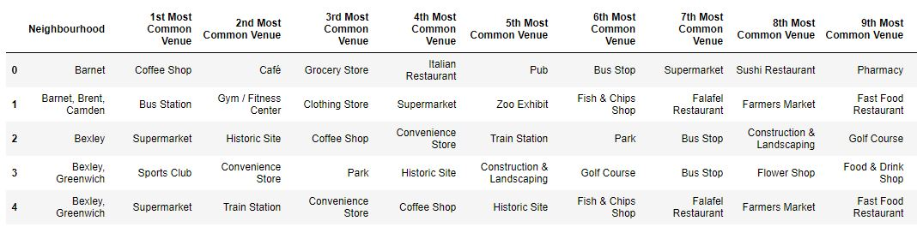
Top Venues in the Neighborhoods

Slide 10
Visualizing the clustered Neighborhoods
Our data is processed, missing data is collected and compiled. The Model is built. All that’s remaining is to see the clustered neighbourhoods on the map. Again, we use Folium package to do so.
We could examine our clusters by expanding on our code using the Cluster Labels column.

Slide 11
Results and Discussion
The neighbourhoods of London are very multicultural. There are a lot of different cuisines including Indian, Italian, Turkish and Chinese. London seems to take a step further in this direction by having a lot of restaurants, bars, juice bars, coffee shops, Fish and Chips shop and Breakfast spots. It has a lot of shopping options too with that of the Flea markets, flower shops, fish markets, Fishing stores, clothing stores.
Paris is relatively small in size geographically. It has a wide variety of cuisines and eateries including French, Thai, Cambodian, Asian, Chinese etc. There are a lot of hangout spots including many Restaurants and Bars. Paris has a lot of Bistros. Different means of public transport in Paris which includes buses, bikes, boats or ferries. For leisure and sightseeing, there are a lot of Plazas, Trails, Parks, Historic sites, clothing shops, Art galleries and Museums.

Slide 12
Conclusion
The purpose of this project was to explore the cities of London and Paris and see how attractive it is to potential tourists and migrants. We explored both the cities based on their postal codes and then extrapolated the common venues present in each of the neighbourhoods finally concluding with clustering similar neighbourhoods together.
References
The Battle of Neighbourhood — My London’s Perspective by Dayo John
The Battle of neighborhoods! What is the best place where can I start my restaurant business in Paris? by Zakaria BOUZIANE
Foursquare API
ArcGIS API

